Slide 1
Blockchain and Logistic Innovation
Zhijie Ren
Cyber Security Group
15-2-2016

Slide 2
Outline
Background
Use Cases
Challenges

Slide 3
Background - Blockchain
Blockchain → Group Consensus
Blockchain ←→ 3rd Party
New technologies → New applications

Slide 4
Background - TrustChain
A up-and-running blockchain applied with video sharing software Tribler.
Multiple blockchains.
Sybil attack resillient.
Lacking of consensus model.
Will be used as test-bed for new schemes.

Slide 5

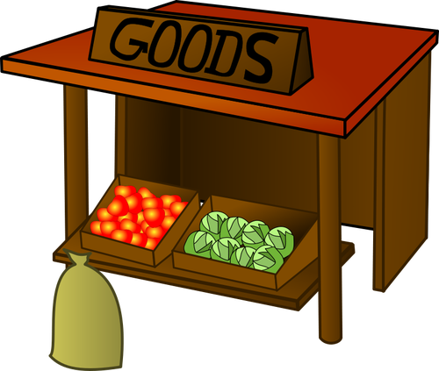
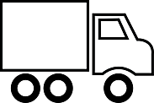
Use Case 1 – Smart Contract for Carriers
Seller
Carrier
Buyer
Goods
Goods

Slide 6
Use Case 1 – Smart Contract for Carriers
Seller
Carrier
Buyer
Goods
Goods
Money
Money

Slide 7

Use Case 1 – Smart Contract for Carriers
Seller
Carrier
Buyer
Goods
Goods
Money
Money
Money
3rd Party

Slide 8
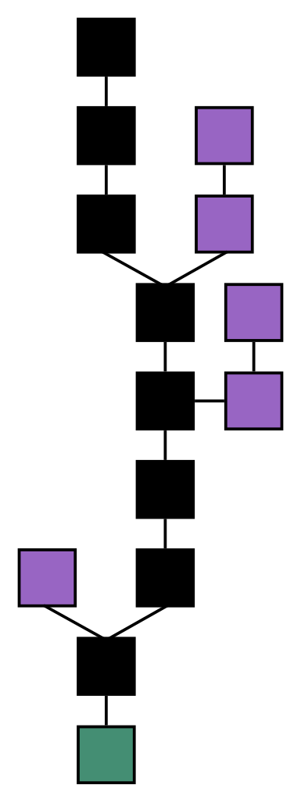
Use Case 1 – Smart Contract for Carriers
Seller
Carrier
Buyer
Goods
Goods
Smart
Contract
Smart
Contract
Smart
Contract
Blockchain

Slide 9

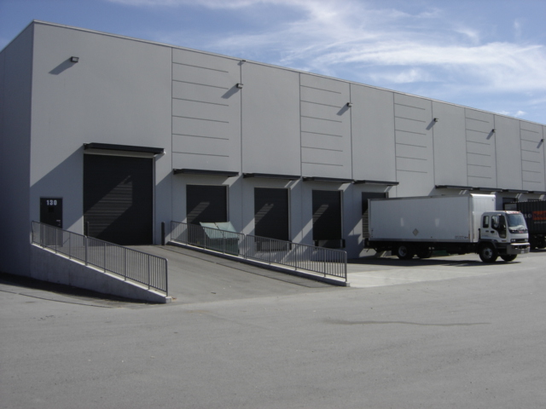
Use Case 2 – Asset Based Inventory finance
Owner
Money
Bank
Proofs
Goods
Warehouse

Slide 10
Use Case 2 – Asset Based Inventory finance
Owner
Money
Bank
Proofs
Goods
Warehouse

Slide 11
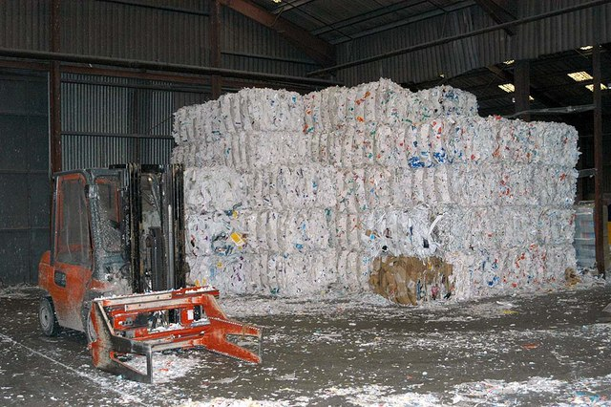

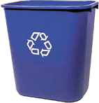
Use Case 3 – Enabling a Circular Economy
Factory
Raw Material
Product
Waste

Slide 12
Use Case 3 – Enabling a Circular Economy
Factory
Raw Material
Product
Blockchain
Waste

Slide 13
Challenges – Consensus Model
A new consensus model based on the TrustChain infrastructure.
No POW (use BFT).
Secure and reliable for applications involving real money.
Support smart contract.
High throughput.
Cost efficiency.

Slide 14
Challenges – Blockchain Security and Anonymity
Privacy issues for real-money involving blockchain.
Some techniques to be considered:
Commitment Scheme
Zero-knowledge Proof
Homomorphic Encryption

Slide 15
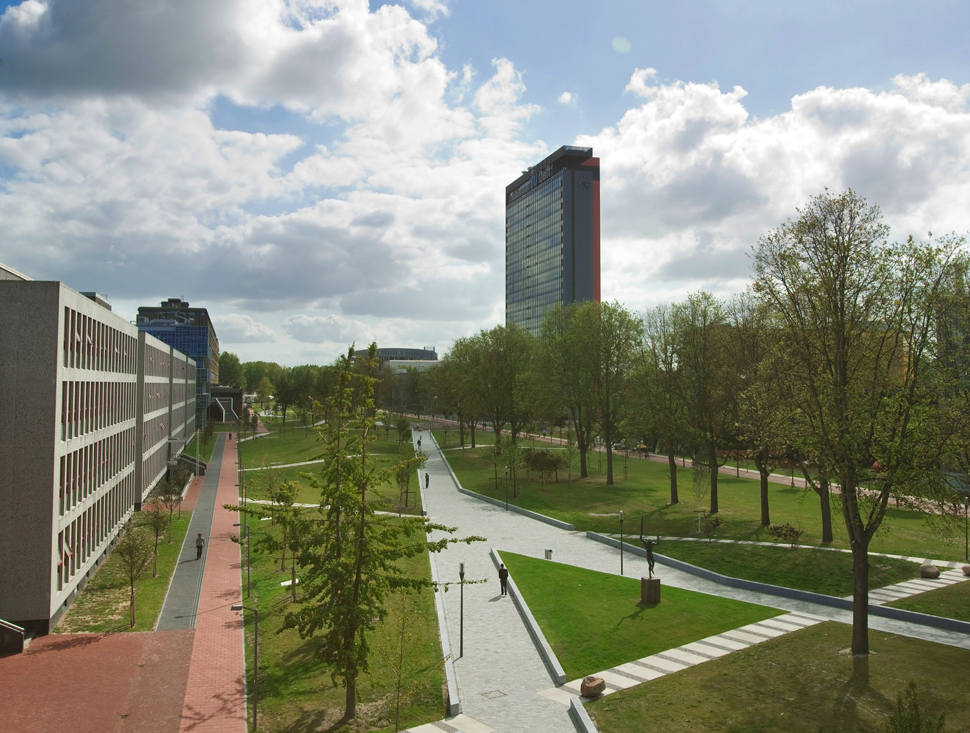
Thank you!

